Slide 1
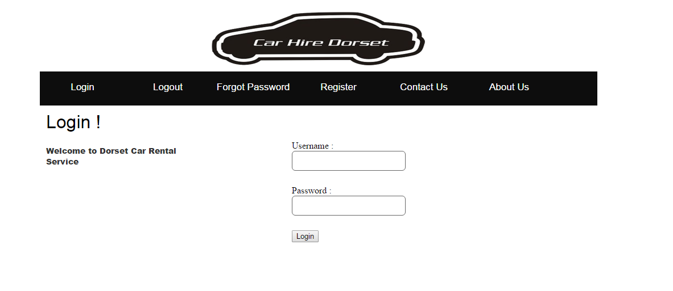
Group : 03 Group Members : S.A.M.Khaled Hasan (14201012) Priyanka Sarkar(12201117) MD. Asiful Haque(12201011) Mutasim Billah (13101275) MD. Mehedi Hasan Shuvo (12101071) Date: 04-08-2015

Slide 3
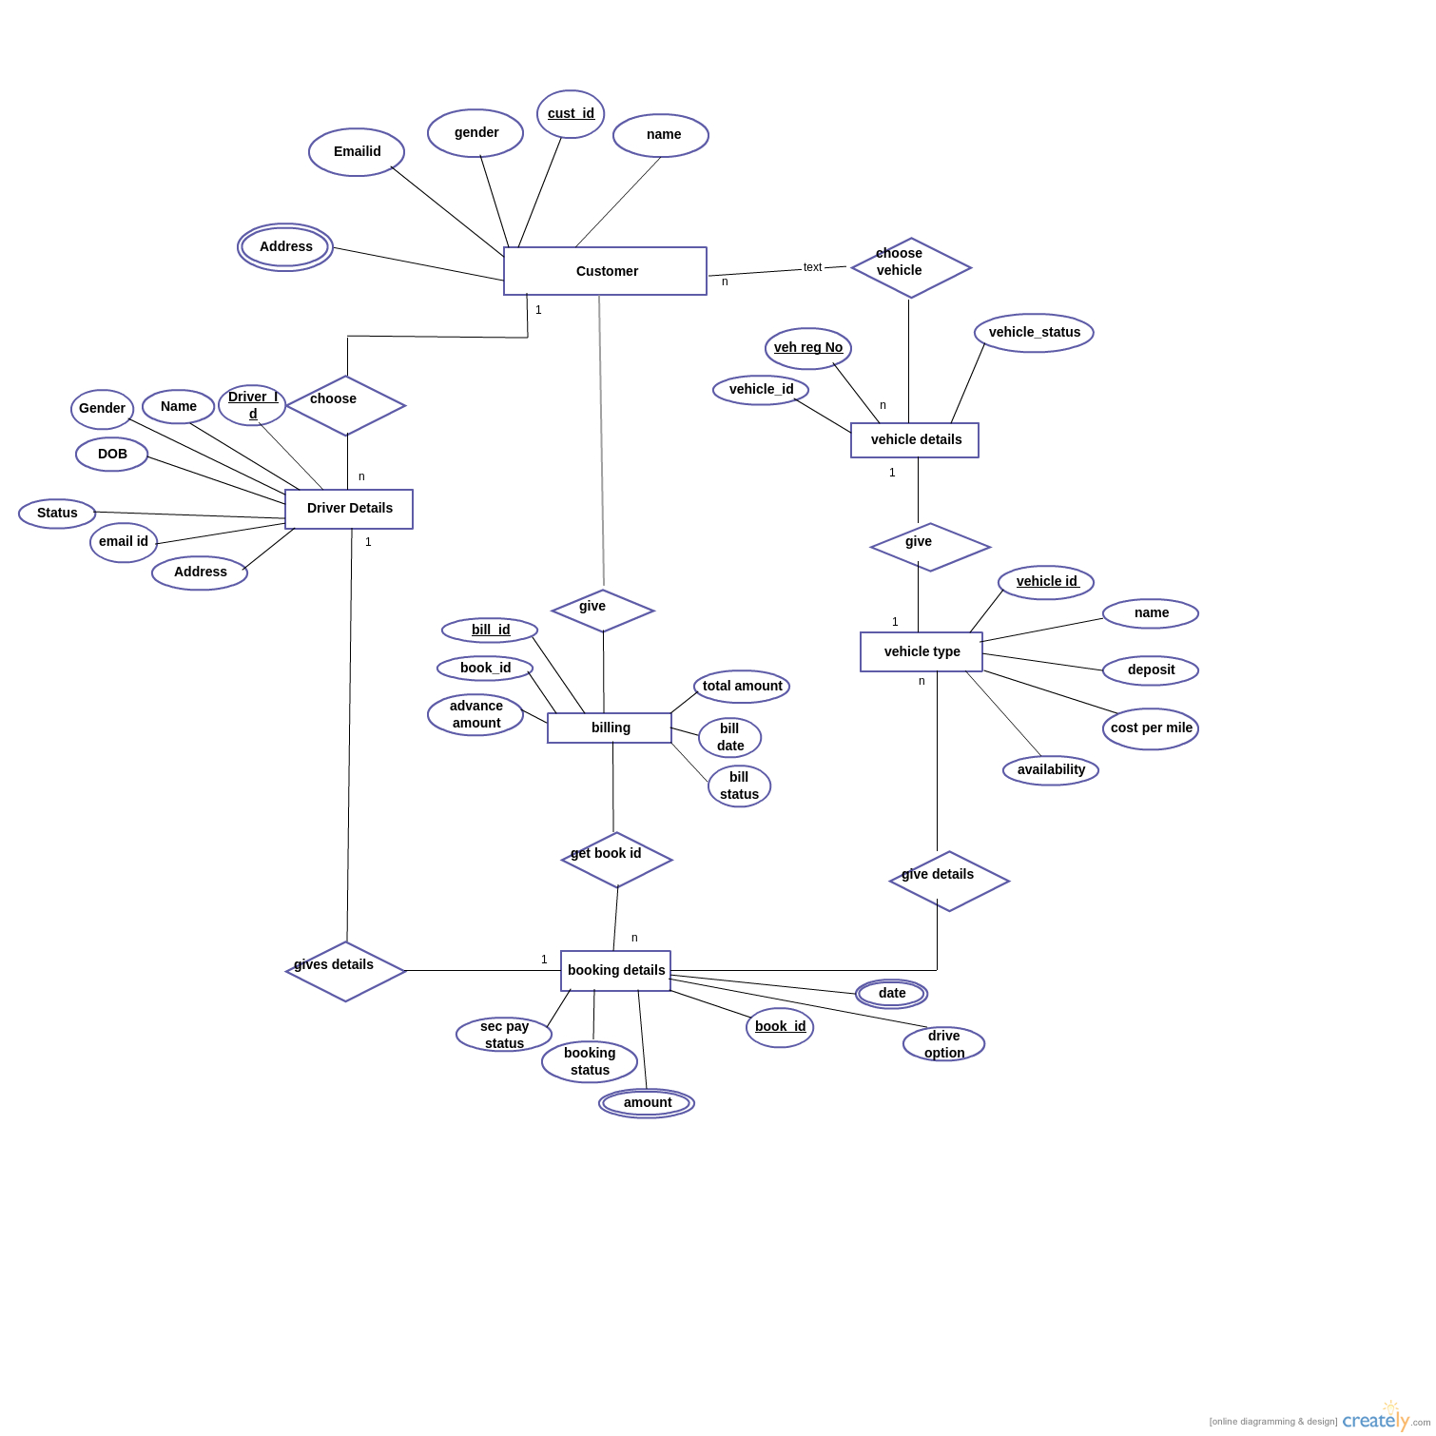
ER-diagram of Car Hire Dorset

Slide 4
SQL
INSERT INTO `rent_a_car_cse370`.`driver_details` (`driver_id`, `name`, `gender`, `dob`, `status`, `email_id`, `address_driver`) VALUES ('12201022', 'Rahim', 'Male', '1991-09-04', '1', 'r@test.com', 'asdfgadsg');
Update :
UPDATE `rent_a_car_cse370`.`driver_details` SET `driver_id` = '12201011', `gender` = 'male', `status` = '1' WHERE `driver_details`.`driver_id` = 1;
Delete :
DELETE FROM `rent_a_car_cse370`.`driver_details` WHERE `driver_details`.`driver_id` = 12201022;

Slide 5
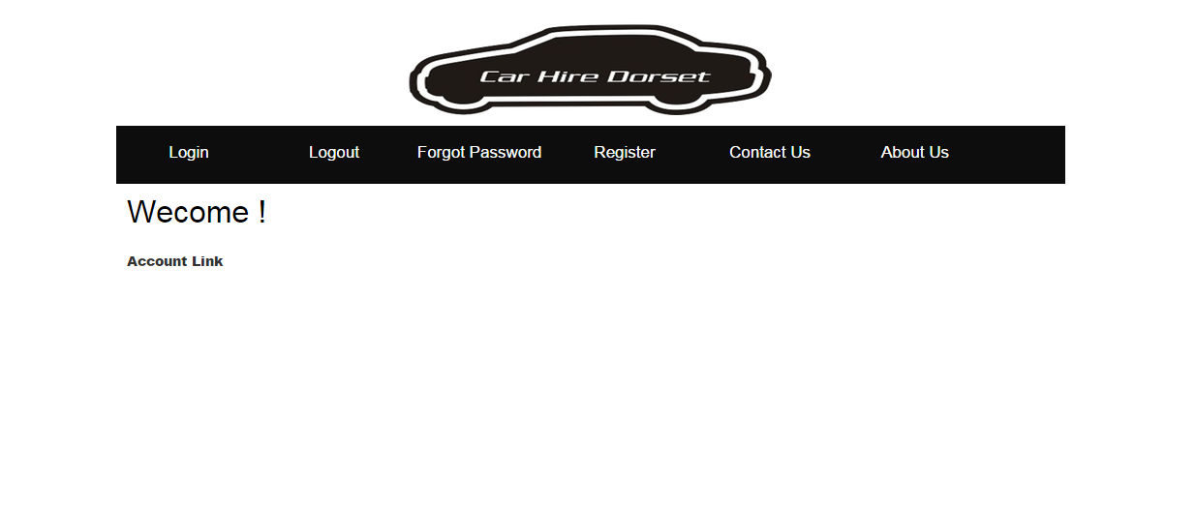
Welcome to our Project!

Slide 6
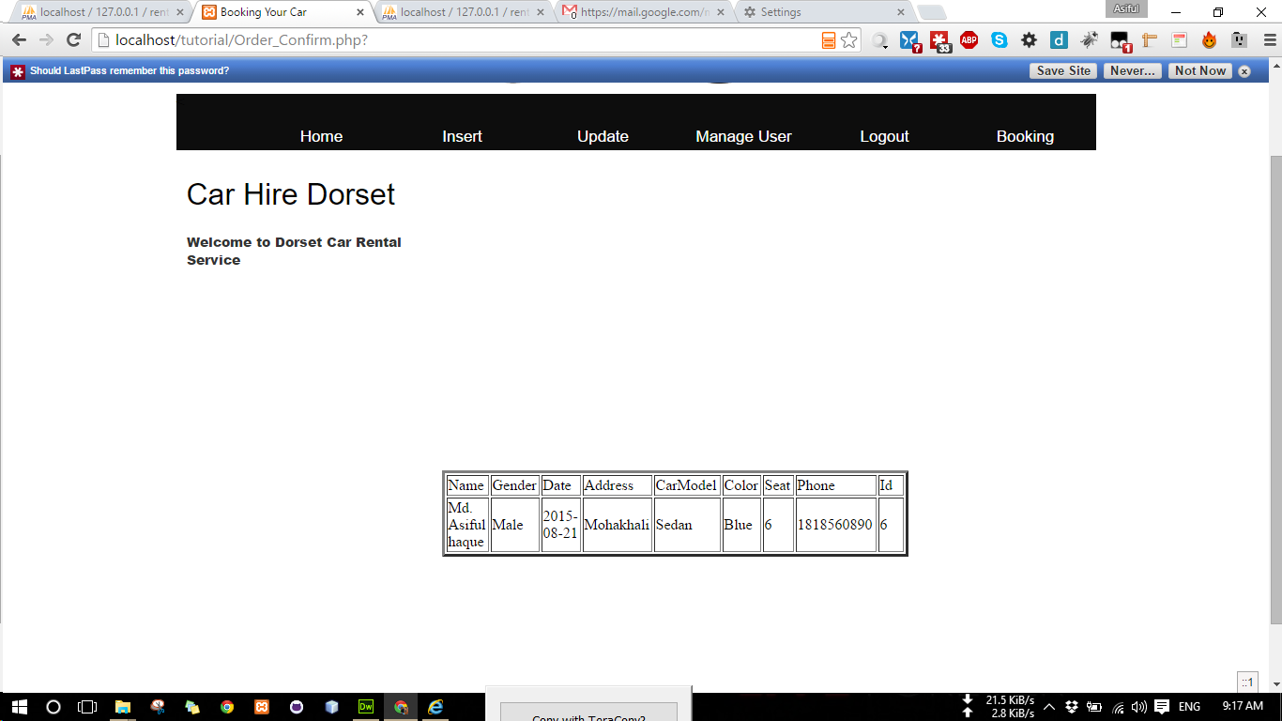

Slide 7
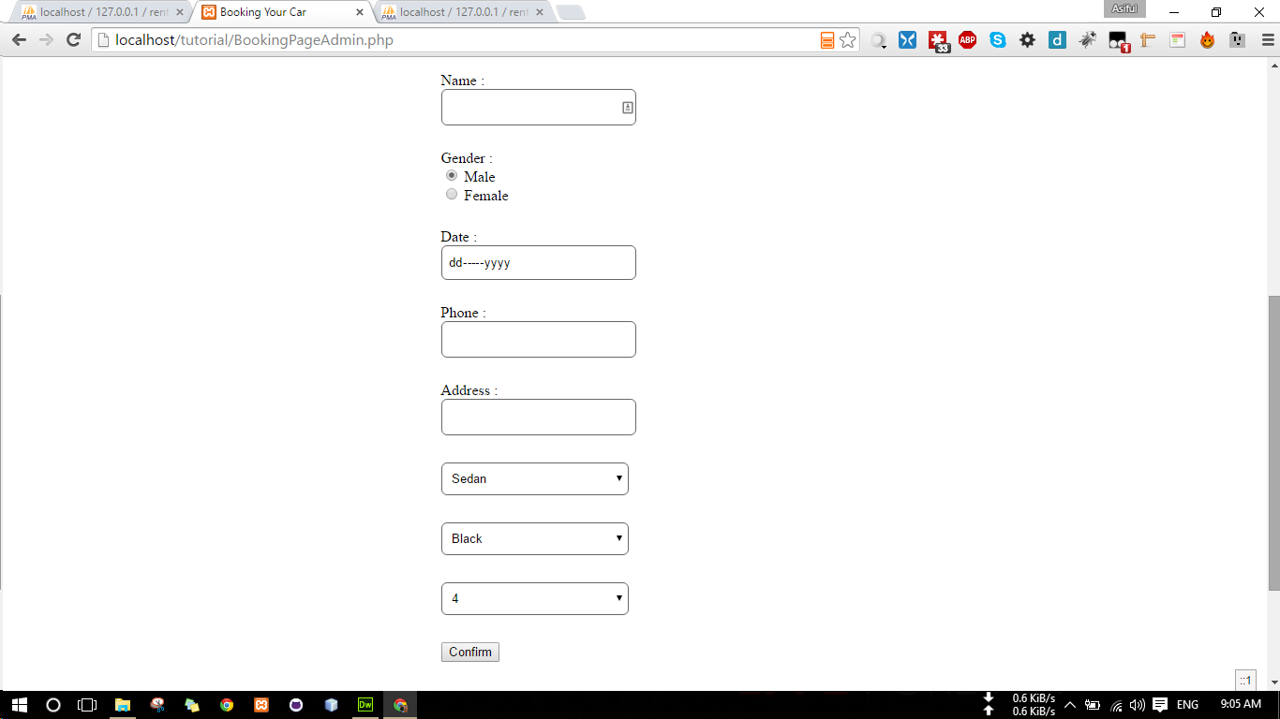

Slide 9
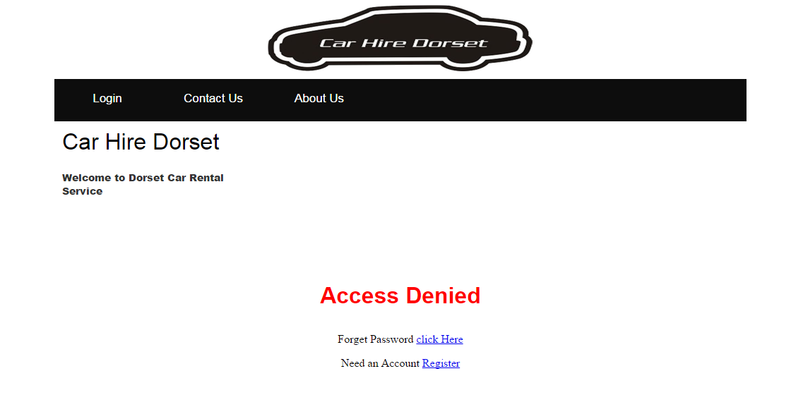
Oops!

Slide 10
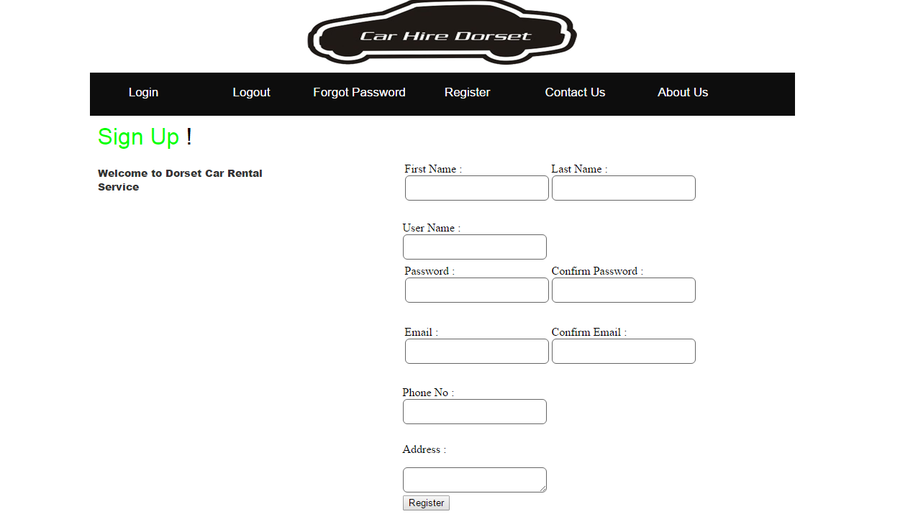
Sign-up to our database!

Slide 11
Login to your account

Slide 12
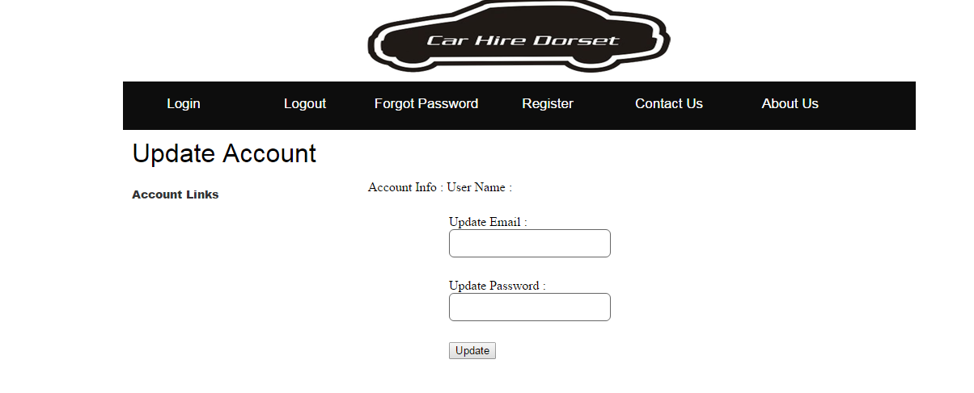
In case you need to change login details…..

Slide 13
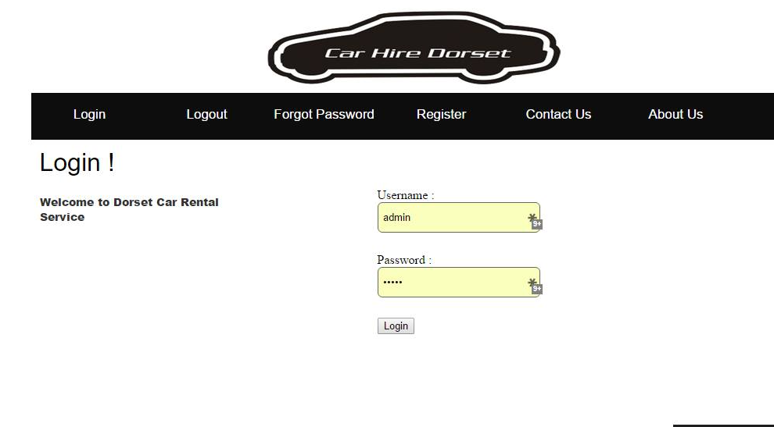

Slide 14
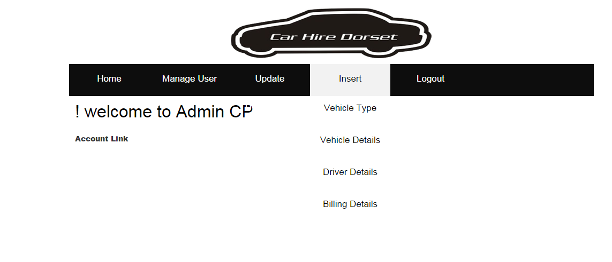
User admin view

Slide 15
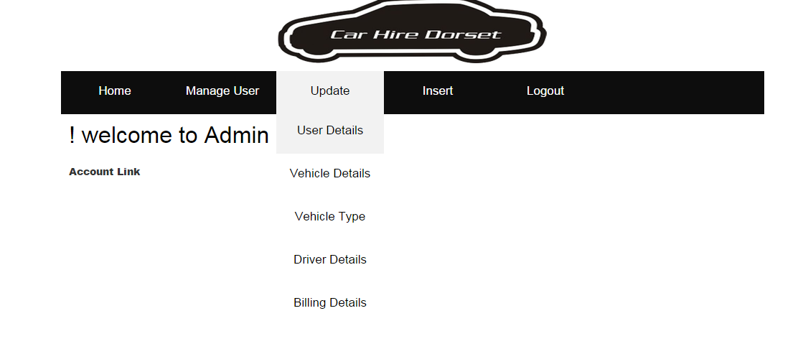

Slide 16
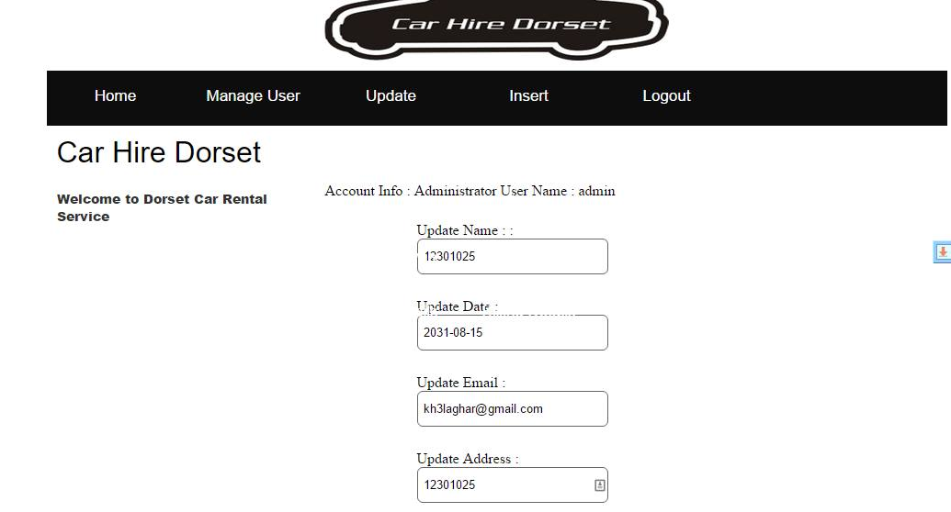

Slide 17
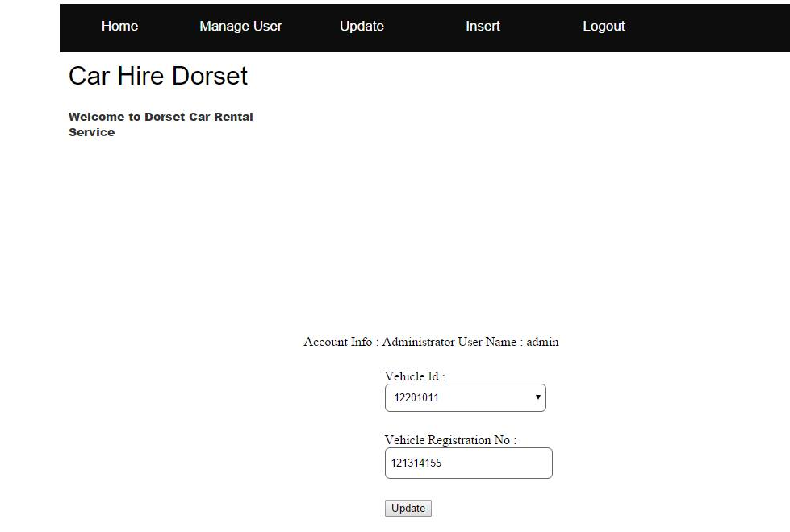

Slide 18
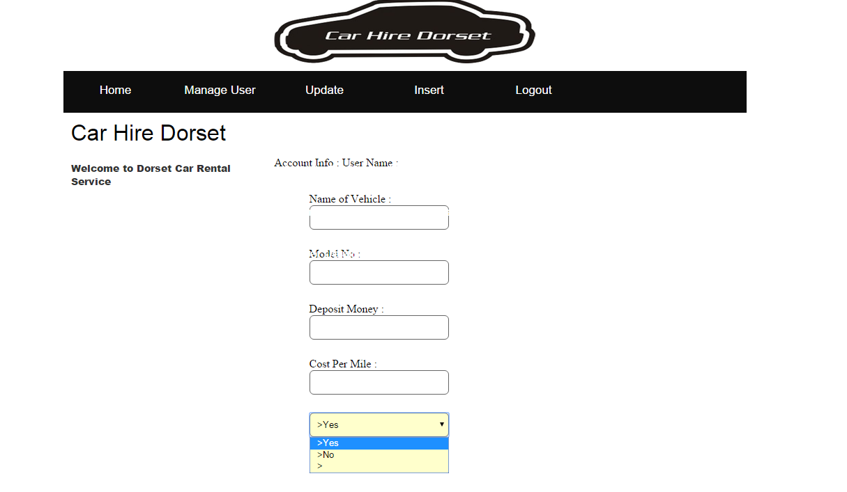
Vehicle details

Slide 19
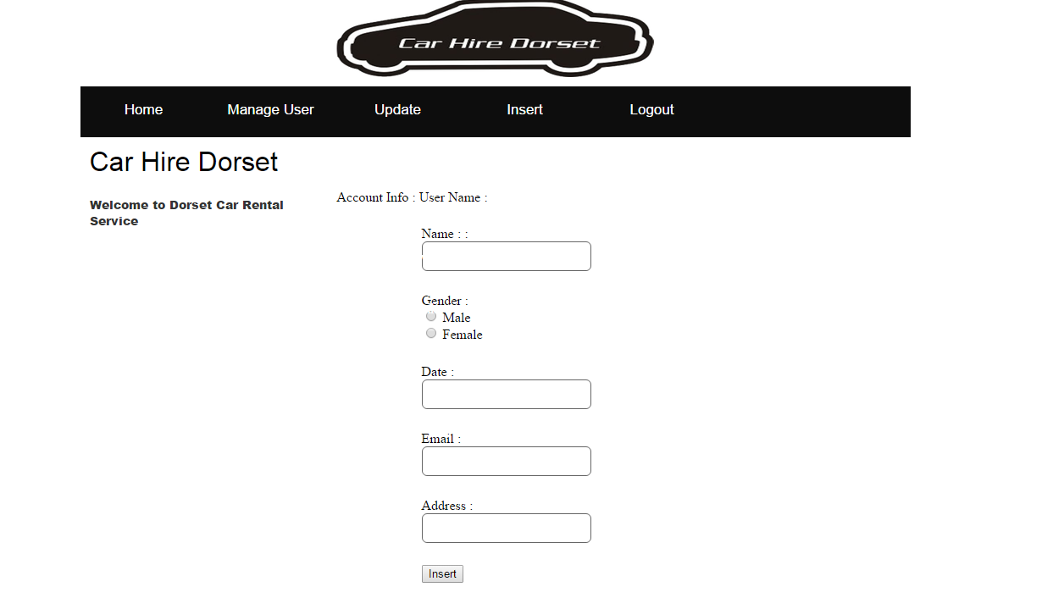
Driver details

Slide 20
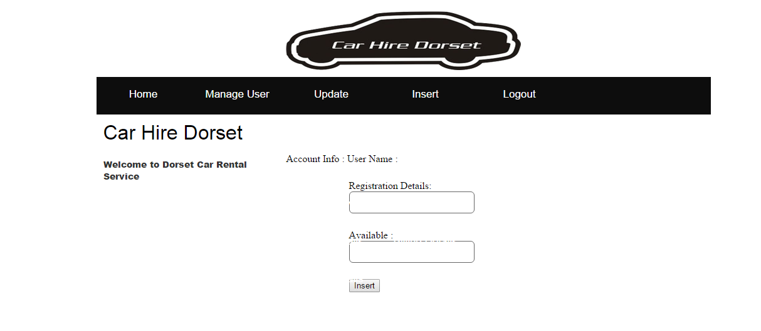
Billing details

